Slide 1

Document Summarization Systems
Dingding Wang

Slide 2

My Research Overview
I have been pursing and will continue to purse a vigorous and competitive research agenda
  Focusing on research challenges grounded in real-world problems
  Studying both algorithmic and application issues
Data Mining, Information Retrieval, Machine Learning
Practical Problems
Generic Tools
Theory/Algorithms
Applications:
Web mining
Bioinformatics
Music information retrieval
Social media analytics
Disaster management
System analytics
Cloud analytics
Health care
Sustainability
Research Issues:
Tools and Libraries:
SumView: Online product review
iHelp: Intelligent helpdesk
Malware scanners
LIBGS: Gene Selection
Twitter Event Summarization
Matrix-based learning framework
Learning from heterogeneous data types
Large-scale data analysis
Stream data mining
Incremental/Online learning

Slide 3
Outline
Document Summarization Systems
  Introduction
  Existing Techniques
New Summarization Methods to Improve System Performance
  Incorporating Semantic Analysis and Its Application
  Semi-Supervised Solution
  Ensemble Solution
Evolution Related Novel Problems
  Comparative Summarization
  Update Summarization
  Storyline Generation

Slide 4



Motivation
A Huge Number of Users in Social Media
A Huge Number of Text Data
1.23 billion
500TB/day
200 million
340 million tweets/day
270 million
10 billion messages/day
Document understanding – discovers useful and meaningful information from large scale documents.

Slide 5
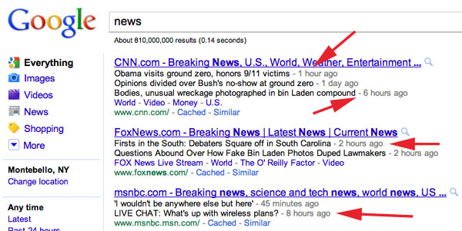


Document Summarization
Multi-Document Summarization - generates a summary by reducing documents in size while retaining the main or query-based characteristics of the original documents.
Applications
documents
sentences
summary

Slide 6
Document Summarization
Related Work
  Centroid-Based Methods
    e.g. MEAD [1]
  Graph-Based Methods
    e.g. LexPageRank [2]
  Latent Semantic Analysis (LSA) [4]
  Nonnegative Matrix Factorization (NMF) [5]
  Other Methods
    e.g. MMR [6], HMM [7], CRF [8], Manifold [3]
Research Issues
  Lack of semantic relationship analysis
  Discover novel problems related to summarization

Slide 7
Contribution 2
Improving Multi-Document Summarization via Semantic Role Analysis

Slide 8
Sentence-Level Semantic Analysis and
Symmetric Matrix Factorization for
Multi-Document Summarization
[Wang et al. SIGIR 2008]
Motivation
  Simple word-matching types of similarity such as cosine can not faithfully capture the content similarity.
  The sparseness of words between similar concepts make the similarity metric uneven.
Solution
  Construct similarity matrix by considering the semantic relationships among sentences.
  Propose symmetric nonnegative matrix factorization to deal with the similarity matrix.

Slide 9
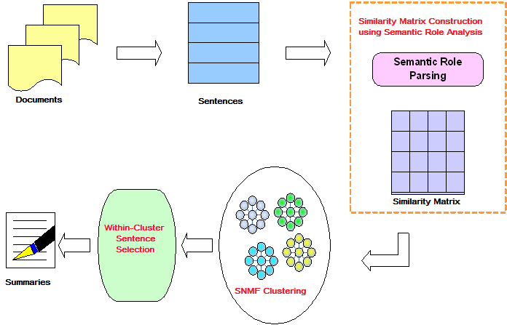
Framework

Slide 10
Semantic Similarity Matrix Construction
Semantic Role Analysis
verb
frame
frames of sentence 1
finding word relations
among words with the
same semantic role in
each frame pair using
WordNet
sentence 1
sentence 2
SENNA
(NEC Parser)
frames of sentence 2
Semantic Roles
For certain verbs of motion
Arg0: causer of motion Arg3: start point
Arg1: thing in motion Arg4: end point
Arg2: distance moved Arg5: direction
-- e.g. [Arg0 I] [ArgM-MOD can][ArgM-NEG not] [rel receive] [Arg1 emails]
  Subtypes of ArgM modifier tag
LOC: location CAU: cause
EXT: extent TMP: time
DIS: discourse connectives PNC: purpose
ADV: general-purpose MNR: manner
NEG: negation marker DIR: direction
MOD: modal verb
  Word Relations
  WordNet 3.0 (147,306 words)
  20 word relations, e.g.identical, synonyms, attribute;
  hypernym and hyponym
  -- A is a hypernym of B if B is a kind of A
  meronym, and holonym
  -- A is a meronym of B if A is a part or member of B
Sentence Similarity Matrix
Similarity score is between 0 and 1

Slide 11
Symmetric Nonnegative Matrix Factorization (SNMF)
Input: similarity matrix W
Target: H
s.t.
Updating rule
After Convergence,
Get H :
sentence - cluster matrix
From H,
Get sentence clusters

Slide 12
Experiments
Data Set
 | DUC2006
Number of topics | 50
Number of documents relevant to each topic | 25
Data source | AQUAINT corpus
Summary length | 250 words
Implemented Systems
LeadBase (leading sentences)
Random
LSA [4]
NMF [5]

Slide 13
Experiments (cont’d)
Phase | Proposed method | Alternative1 | Alternative2
Similarity Measurement | Semantic similarity (SLSS) | Keyword-based
Clustering Algorithm | SNMF | K-means (KM) | NMF
Evaluation Methods
ROUGE [9] toolkit (version 1.5.5) - measures the quality of a summary by counting the unit overlaps between the candidate summary and a set of reference summaries.
Rouge-N: n-gram recall
Rouge-L: the longest common subsequence (LCS) statistics
Rouge-W: weighted LCS
Rouge-SU: skip-bigram plus unigram

Slide 14
Experimental Results
Systems | ROUGE-1 | ROUGE-2 | ROUGE-L | ROUGE-W | ROUGE-SU
LeadBase | 0.32082 | 0.05267 | 0.29726 | 0.10993 | 0.10408
Random | 0.31749 | 0.04892 | 0.29384 | 0.10779 | 0.10083
NMFBase | 0.32374 | 0.05498 | 0.30062 | 0.11341 | 0.10606
LSA | 0.33078 | 0.05022 | 0.30507 | 0.11220 | 0.10226
KM (keyword) | 0.33558 | 0.05920 | 0.32112 | 0.12614 | 0.11229
KM (SLSS) | 0.36371 | 0.06182 | 0.34114 | 0.12966 | 0.12503
NMF (keyword) | 0.33869 | 0.05891 | 0.31286 | 0.12719 | 0.11403
NMF (SLSS) | 0.34372 | 0.05941 | 0.32386 | 0.12973 | 0.11706
SNMF (keyword) | 0.38801 | 0.08304 | 0.36103 | 0.13361 | 0.13187
SNMF (SLSS) | 0.39551 | 0.08549 | 0.36803 | 0.13943 | 0.13981

Slide 15
Summary
The performance of multi-document summarization is improved via:
  Sentence-level semantic analysis
  Clustering on similarity matrix via symmetric nonnegative matrix factorization

Slide 16
Application:
iHelp – An Intelligent Online Helpdesk System
[Wang et. al. IEEE Transactions on SMC 2010]
Motivation
  Current customer service (also called helpdesk, call center, etc.) involves a lot of manual operations
  It is difficult to transfer knowledge and experience between representatives
  One solution is case-based system to find whether similar requests have been processed before
Challenges
  Case retrieval methods
  Result representation
iHelp
  employs sentence-level semantic analysis to better understand the semantic meanings of the cases (semantic role analysis)
  performs the case clustering using SNMF to capture different scenarios in the top-ranking past cases that are related to the given problems (SNMF)
  generates a concise description for each scenario to improve the system usability (summarization)

Slide 17
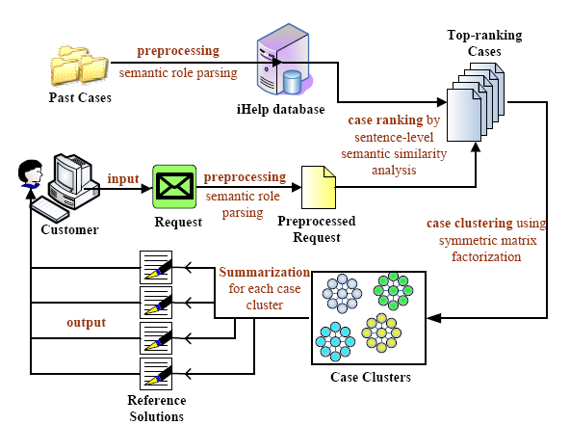
Application:
iHelp – An Intelligent Online Helpdesk System
Framework

Slide 18
Application:
iHelp – An Intelligent Online Helpdesk System
Screenshot

Slide 19
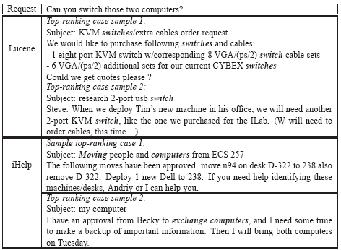
Application:
iHelp – An Intelligent Online Helpdesk System
Case Study
Scenario : Can you switch those two computers?
Apache Lucent v.s. iHelp
top ranking cases
sample summaries

Slide 20
Improving Multi-Document Summarization
Summary
  Aggregating different document summarization methods
  Semantic analysis on sentence relationships instead of shallow keyword co-occurrence analysis
  Intelligent helpdesk system application

Slide 21
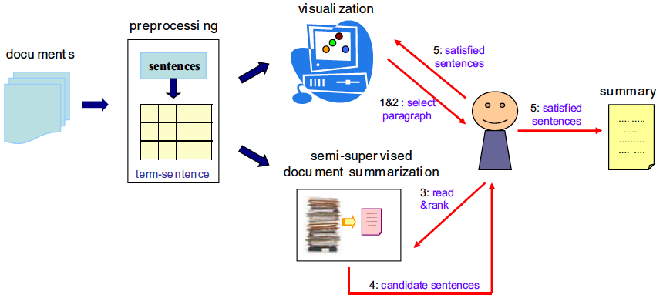
Semi-Supervised Document Summarization
(Zhang, Wang & Li, PKDD/ECML 2011)
Problem
solutions
  Paragraph selection: random, centroid-based, location-based, most “important”, etc.
  A variety of semi-supervised learning methods with order preference
unsupervised
ask users to rank sentences in some paragraphs
semi-supervised

Slide 22
Ensemble Summarization
Problem
Solutions
  Aggregate ranking, e.g. average, weighted, and Round Robin
  Construct weighted sentence graph from summaries generated
  by different methods.
(Wang & Li, IPM 2011)
combine results of a set of summarization systems under the assumption that the results of different systems are complementary to each other
…
…
summarization methods
summaries
ensemble summary

Slide 23
Contribution 3
Evolution-Related Novel Problems
Comparing Different Documents
Update Summarization
Generating Pictorial Storyline

Slide 24




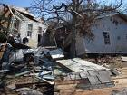





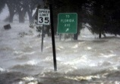


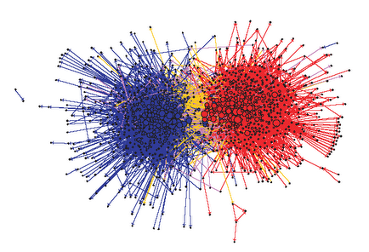
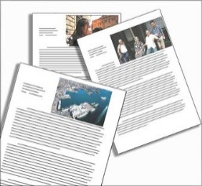
Comparative Document Summarization (CDS)
[Wang et al. TKDD 2013]
Motivation
Blog Communities
summarizing differences between comparable document groups

Slide 25
CDS
Problem Description
Task: Extract sentences to best discriminate documents of different groups
sentence
1
document in group 1
sentence-document similarity
sentence-sentence similarity
2
2
3
1
1
3

Slide 26
CDS
Discriminative Sentence Selection
  minimize average variance of all targets (or the trace of the covariance)
Z=[X,Y]
solved by transductive active learning [10]
sentence
label
doc
similarity
sentence
Computational Algorithm
1: 2: 3: Repeat 4: 5: 6: 7: until |S|=m.
similarity
X
Y
sentence
∑: covariance matrix
Obj:
T: index set in Z corresponding to the targets Y
S: index set of selected sentences
I
W

Slide 27
CDS
Experiments
Data set
Blog data: 274,679 English blog entries in the topics of technology and politics in 441 days (63 weeks) between July 10th in 2005 and September 23rd in 2006.

Slide 28
A Case Study
K-means on
sent-term
matrix
LSA
NMF on
sent-term
matrix
LeadBase
1. there is no cold war, there is no saddam. lebanon has
also changed.
[war and Terrorist]
2. he should drop the case against the lacrosse players
but not the sexual assault case itself.
[Duke Lacrosse Case]
3. rahman, who is about 41 years old, converted from
islam to christianity over 16 years ago.
[Religion]
4. in both the short and long term what those displaced
by hurricane katrina need most is money.
[Hurricane Katrina]
5. to be totally honest with you, we believed that there
may have been a classified annex.
[911 Commission]
6. i suspect that his position reflects conventional
wisdom among the chinese military establishment.
[China]
7. if hiring rap sheet-free intelligent people means they
won't hire a black applicant for another five years.
[Race Issues]
1. a shift to "no proxy war" would put it in a vise between
israel and iraq.
[War and Terrorist]
2. he didn't say it was gone; plenty of journalists still
heard the call.
[Religion] X
3. blacks tend to attack blacks, and whites tend to
attack whites.
[Duke Lacrosse Case] X
4. not going to discuss my or cnn's coversations with
the chinese government, he said.
[China]
5. while the feds were killing themselves to get poor
black people out the city, the white people got ignored.
[Hurricane Katrina]
6. one cannot help but draw the conclusion, especially
in this case, that the commission deliberately excluded
it from their report.
[911 Commission]
7. my indignation against this garbage is only one of
many reasons black liberals "take issue" with me.
[Race Issues]
1. the washington post has the best reporting from iraq
that i've found.
[War and Terrorist]
2. when I first saw the movie Carmen Jones, I was
convinced that back in the day, Harry Belafonte was
the finest thing walking.
[Race Issues] X
3. the "duke rape" case has been salaciously splashed
all over the news.
[Duke Lacrosse Case]
4. One More Look At Prague My last post reviews a
rather obscure report on the discovery of an Iraqi spy
ring in Germany in February or March of 2001, resulting
in the capture of two Iraqi Intelligence Services agents.
[911 Commission] X
5. Notes on Chinese first-strike threat Since I think
it's probably the most important real story of the day.
[China]
6. "Things I Used to Teach that I No Longer Believe"
was the Title of the Panel... ...at the journalism
professors' annual convention.“
[Religion] X
7. several people have asked what, if anything,
they could do to help.
[Hurricane Katrina]
1. for this, he says, the bush team "needs the dying,
withering, but still powerful press axis."
[War and Terrorist] X
2. start with the predominantly black, heavily-funded
government school system in our nation's capital.
[Race Issues]
3. there is no current trend of white men raping black
women, in other words.
[Duke Lacrosse Case]
4. one person comes to the commission a week prior
to the release of the report and says, wait.
[911 Commission]
5. chinese sources seem to raise doubts on the official
government version of the story.
[China]
6. he didn't say it was gone; plenty of journalists still
heard the call.
[Religion] X
7. while the feds were killing themselves to get poor black
people out the city, the white people got ignored.
[Hurricane Katrina]
Discriminative Sentence Selection
1. he didn't say it was gone; plenty of journalists still
heard the call.
[Religion] X
2. no one, of course, wants to wait for the evidence except
the prosecutor, who hasn't charged anyone.
[Duke Lacrosse Case]
3. but in march, kleinsmith was ordered to cease all work
on the project.
[China] X
4. s. o'brien: you're telling me the president told you
the governor said she needed 24 hours to make a decision?
[Hurricane Katrina]
5. while the feds were killing themselves to get poor black
people out the city, the white people got ignored.
[Hurricane Katrina]
6. 80% of what the national media has reported thru all
this was flawed in some non-trivial way.
[Hurricane Katrina]
7. german authorities, acting on cia recommendations,
had been focused on monitoring the activities of islamic
groups linked to bin ladin.
[911 Commission]
NMF on doc-sent similarity matrix
1. the column correctly identifies tehran's diplomatic
game: iran's hezbollah proxies engaging israel deflects
political attention from iran's nuclear shenanigans.
2. the lebanese have also experienced twenty years of
syrian occupation and thuggery.
3. it suggested the case but not at the center of its
public diplomacy.
[1~3: War and Terrorist] X
4. the first thing whites do when making these decisions
is appeal to the lowest element.
[Race Issues] X
5. if analysts could establish a legitimate reason to
investigate a person further, they could keep the
corresponding data.
[China] X
6. purchasing power parity, ppp, is among other things,
a way to let poor countries feel better about themselves.
[Religion]
7. if you're comfortable with that arrangement i'd
like to personally encourage you to donate.
[Hurricane Katrina]
1. after watching the media bungle the coverage in new
orleans, i can only imagine what is really happening in iraq.
[Hurricane Katrina]
2. the federal prosecutor's office has had two iraqi men
arrested on sunday and tuesday of this week.
[911 Commission]
3. The system is designed to keep you running in circles
so you won't see the real issues.
[Race Issues] X
4. a snippet: even in a country that celebrates free speech,
you don't spontaneously vocalize grievances at state events.
[China Related]
5. i discussed this in earlier posts, but it bears repeating:
terrorists can change tactics situationally.
[911 Commission]
6. indeed... update 2 (by kevin): two issues with the story
have been raised via comment and trackback.
[Hurricane Katrina] X
7. reform efforts have been slow, say experts, since there
are so few judges and lawyers with experience.
[Religion] X
LeadBase
Community centers
LSA
K-means on sent-term matrix
NMF on sent-term matrix
7 communities
War and Terrorist, Race Issues, Duke Lacrosse Case, Religion, 911 Commission, China, Hurricane Katrina
Our active
Selection
Community
centers
NMF on
doc-sent
similarity
matrix

Slide 29
CDS
  A novel problem to compare and summarize documents is defined.
  Different from traditional multi-document summarization, our work aims to find the differences between document groups.
  Instead of word level comparison, it’s more natural to select sentence features.

Slide 30
Update Summarization
[Wang et. al. CIKM 2010]
Motivation
  The summaries need to be updated periodically.
  Current batch document summarization methods requires repeatedly processing previous existing documents.
  In some real applications, e.g., disaster management, the time delay is unacceptable.
New Problem
updating summaries as soon as new documents arrive
Our Solution
incremental hierarchical clustering

Slide 31
Update Summarization
Framework
documents→sentences
new documents
multi-documents
remove stopwords
stemming
sentence matrix
Preprocessing
Our Solution: IHC
length of summary
summary
…
…
Incremental Hierarchical Clustering based Update Summarization Engine

Slide 32
Update Summarization
Why IHC
  Efficiently process the dynamic documents in the sense that new documents are continuously added to the data set
  Built a hierarchy to facilitate users to explore the structure and relationship between the sentences
  The number of clusters is not pre-defined so that users can cut the hierarchy tree at any level based on their needs

Slide 33
Update Summarization
Cobweb
  Category Utility (CU) - the criterion function to determine the partitions in the hierarchy [15, 16]
  Four Operations
  Insert: add the sentence into an existing cluster.
  Create: create a new cluster.
  Merge: combine two clusters into a single cluster.
  Split: divide an existing cluster into several clusters.

Slide 34
Update Summarization
Case 1: If insert a sentence into clusterk, then recalculate the representative sentence Rk of clusterk using
Case 2: If create a new clusterk, the newly coming sentence snew represents the new cluster, i.e., Rk = snew
Case 3: If merge two clusters clustera and clusterb into a new cluster clusterc, the sentence obtaining the higher similarity with the query is selected as the representative sentence at the new merged node.
Case 4: If split clustera into a set of clusters as {cluster1, cluster2, ..., clustern}, remove node a and substitute it using the roots of its subtrees. The corresponding representative sentences are the representative sentences for the original subtree roots {R1,R2, ...,Rn}.

Slide 35
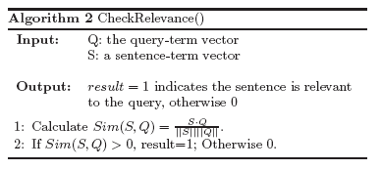
Update Summarization
Algorithm

Slide 36
Update Summarization
Data Set
  Hurricane Wilma Releases (Hurricane) - press releases by Miami-Dade County Department of Emergency Management and Homeland Security during Hurricane Wilma from Oct. 19, 2005 to Nov. 4, 2005.
  1,700 documents of 3 phases:
  (1) preparation before hurricane Wilma
  (2) damage during the growth of Wilma
  (3) the recovery after the hurricane. The approximate numbers of documents obtained at the end of the three phases are 360, 1310, and 1700, respectively.
Data Annotation
  10 human labelers, 10 queries, 3 phases
  Each query is given to 5 different annotators
  Each annotator creates three 100 words summaries for each query

Slide 37
Update Summarization
Example
Sample150 reports from the original dataset
Query: What are the situations of Miami-Dade County services including public transit, airport information and public schools?
Phase 1
root
All Miami-Dade County
services continue normal
operations.
Miami International
Airport is open.
A decision has not yet been made as to whether Miami Dade Public Schools will be open on Monday.
All Miami-Dade County services continue normal
operations.
Miami-Dade transit will be providing including Metrobus and Metrorail.
Miami International Airport is open.
However, please check with your airline for flight information.

Slide 38
Update Summarization
Example
root
Phase 2
Miami-Dade transit
bus and rail service
remain closed.
Miami International
Airport is will remain
closed.
Miami-Dade County
Public Schools closed
through Tuesday.
All Miami-Dade County services continue normal
operations.
Miami-Dade transit
bus and rail service
remain closed.
Miami International
Airport is open.
Airlines are not expected to resume operations.
Miami International
Airport will remain
closed.
A decision has not yet been made as to whether Miami Dade Public Schools will be open on Monday.
Miami-Dade transit is not in operation and will continue to be closed for at least 48 hours.
Miami-Dade transit
bus and rail service remain closed.
Miami International Airport is open.
However, please check with your airline for flight information.
On Monday, Miami-Dade County public schools will be closed.
Miami-Dade County Public Schools closed through Tuesday.

Slide 39
Update Summarization
Example
Phase 3
root
Miami-Dade transit
bus and rail service
remain closed.
Miami International
Airport has re-opened
with limited service.
Miami-Dade Public
Schools will remain
closed on Wednesday.
Services is expected to begin this evening.
Miami-Dade transit
bus and rail service
remain closed.
All Miami-Dade County services continue normal
operations.
Miami International
Airport is open.
Miami International
Airport will remain
closed.
Miami International
Airport has re-opened with limited service.
Metrorail is undergoing repairs.
A decision has not yet been made …
Miami-Dade Public Schools will remain closed on Wednesday.
Miami-Dade transit is not in operation …
Miami-Dade transit
bus and rail service remain closed.
Miami International Airport is open.
However, please check …
Airlines are not expected to resume operations.
Miami International
Airport will remain
closed.
…

Slide 40
Update Summarization
Example
3-sentence summaries

Slide 41
Pictorial Storyline Generation
[Wang et al. AAAI 2012]
Motivation
  Summarization lack of the theme structure to capture the event evolution.
  Timeline systems present the sequence of events based on the order of time, the linear-structured timelines usually lose comprehensive information of the evolutionary processes [11, 12].
  Only texts are presented as summaries.
New Problem
generating a novel framework of pictorial and temporal storylines
Our Solution
minimum weighted connected dominating set approximation in multi-view graphs

Slide 42

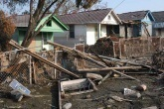
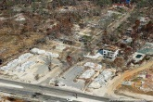




Pictorial Storyline Generation
System framework
System Input
A query and a collection of images and corresponding texts
query
multi-view objective graph G:=(V,E,A)
dominating objectives on graph G:=(V,E)
storyline generation via steiner tree construction on graph G:=(V,A)
… ..
System Output
… …
… ..
… ..
… ..
… ..
A pictorial storyline with summarized texts

Slide 43

Pictorial Storyline Generation
Identifying Query-relevant Dominating Objects
The Minimum-Weight Dominating Set Problem (MWDS)
Given a vertex-weighted undirected graph G, from all dominating sets of G the one whose total vertex weight is the smallest.
It is an NP-hard problem.
Approximation Algorithm [13]
Algorithm: Greedy MWDS Approximation
Input: G=(V, E): vertex weighted object graph
W: maximal number of dominators
Output: dominating set S
$S=∅$
T$=∅$
while $|S|<W$ and S!=V do
for $v∈V−S$ do
$S\left(v\right)=\left\|\{v^{′}|(v^{′},v)∈E\}\backslash T\right\|$
$v^{∗}={argmin}_{v}\frac{w(v)}{s(v)}$
$S=S∪\left\{v^{∗}\right\}$
$T=T∪\{v^{′′}|(v^{′′},v^{∗})∈E\}$

Slide 44
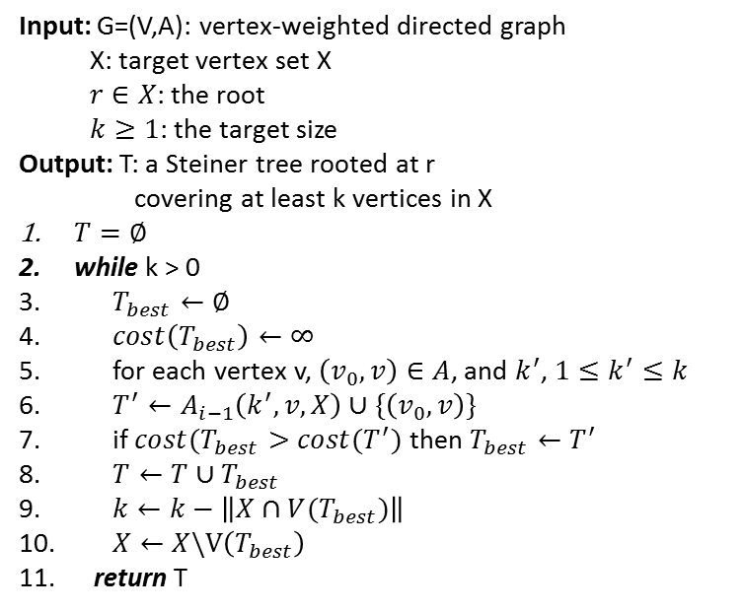
Pictorial Storyline Generation
Generating Storylines by Connecting Dominating Objects via Directed Steiner Tree Steiner Tree
A Steiner tree of a graph G w.r.t. a vertex subset X is the edge-induced subtree of G that contains all the vertices of X having the minimum total cost, where the cost is the total weight of the vertices.
Approximation Algorithm [14]
Algorithm: $A_{i}(G,k,r,X)$
Input: G=(V,A): vertex-weighted directed graph
X: target vertex set X
$r∈X$: the root
$k≥1$: the target size
Output: T: a Steiner tree rooted at r
covering at least k vertices in X
$T=∅$
while k > 0
$T_{best}←∅$
$cost\left(T_{best}\right)←∞$
for each vertex v, $\left(v_{0},v\right)∈A$, and $k^{′}$, $1≤k^{′}≤k$
$T^{′}←A_{i−1}\left(k^{′},v,X\right)∪\{\left(v_{0},v\right)\}$
if $cost(T_{best}>cost(T^{′})$ then $T_{best}←T^{′}$
$T←T∪T_{best}$
$k←k−\left\|X∩V(T_{best})\right\|$
$X←X\backslash V\left(T_{best}\right)$
return T

Slide 45
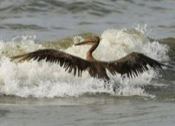


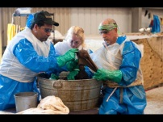
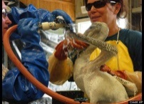
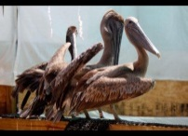
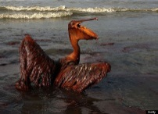
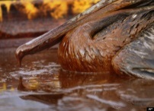
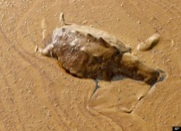

Pictorial Storyline Generation
An oiled pelican unable to fly tries to leap over a wave on the shore of Isle Grande Terre.
06/04/2010
An oil-covered pelican tries unsuccessfully to fly off a post at Wilkerson Canal.
06/05/2010
Volunteers clean an oil covered brown pelican found off the Louisiana coast and affected by the BP Deepwater Horizon oil spill in the Gulf of Mexico.
06/09/2010
A brown pelican chick that had just been washed in the center for birds oiled from the Gulf of Mexico spill.
06/11/2010
Rescued pelicans cleaned of oil are seen at The Sector Mobile Wildlife Operations Branch.
06/14/2010
An oil covered brown pelican sits behind another bird on the beach at East Grand Terre Island along the coast of Louisiana.
06/03/2010
A brown pelican coated in heavy oil wallows in the surf.
06/04/2010
An oil covered pelican sits stuck in thick beached oil at Queen Bess Island in Barataria Bay.
06/05/2010
Query: “How BP oil spill affects animals such as pelicans and turtles?”
A dead turtle floats on a pool of oil from the Deepwater Horizon spill in Barataria Bay off the coast of Louisiana.
06/07/2010
Oceana explains the variety of threats to sea turtles from the
spill as well as risks specific to the different species of turtle that inhabit the affected area.
06/09/2010
An Illustrative Example

Slide 46
Evolution-Related Novel Problems
Summary
Three successful examples of capturing the differences/changes and evolution of documents over time:
    Comparing documents and summarizing differences
    Update summarization
    Generating storylines to update event development

Slide 47
References
[1] D. Radev, H. Jing, M. Stys, and D. Tam. Centroid-based summarization of multiple documents. Information Processing and Management, pages 919–938, 2004.
[2] G. Erkan and D. Radev. Lexpagerank: Prestige in multi-document text summarization. In Proceedings of EMNLP, 2004.
[3] X. Wan and J. Yang. Multi-document summarization using cluster-based link analysis. In Proceedings of SIGIR 2008.
[4] Y. Gong and X. Liu. Generic text summarization using relevance measure and latent semantic analysis. In Proceedings of SIGIR 2001, pages 19–25, 2001.
[5] S. Park, J. Lee, D. Kim, and C. Ahn. Multi-document summarization based on cluster using non-negative matrix factorization. In Proceedings of SOFSEM ’07, pages 761–770, 2007.
[6] J. Goldstein, M. Kantrowitz, V. Mittal, and J. Carbonell. Summarizing text documents: Sentence selection and evaluation metrics. In In Research and Development in Information Retrieval, pages 121–128, 1999.
[7] J. Conroy and D. O’leary. Text summarization via hidden markov models. In Proceedings of SIGIR’01, pages 406–407, 2001.
[8] D. Shen, J. Sun, H. Li, Q. Yang, and Z. Chen. Document summarization using conditional random fields. In Proceedings of IJCAI’07, pages 2862–2867, 2007.
[9] C. Lin and E. Hovy. Automatic evaluation of summaries using n-gram co-occurrence statistics. In Proceedings of NAACL ’03.
[10] S. Zhu, D. Wang, K. Yu, T. Li, and Yihong Gong. Feature selection for gene expression using model-based entropy. In IEEE/ACM Transactions on Computational Biology and Bioinformatics, 2008.
[11] R. Yan, X. Wan, J. Otterbacher, L. Kong, X. Li, and Y. Zhang. Evolutionary timeline summarization: a balanced optimization framework via iterative substitution. In Proceedings of SIGIR’11.
[12] O. Alonso, R. Baeza-Yates, and M. Gertz. Effectiveness of temporal snippets. In Proceedings of WWW’09.
[13] C. Shen and T. Li. Multi-document summarization via the minimum dominating set. In Proceedings of COLING ’10.
[14] M. Charikar and C. Chekuri, C. Approximation algorithms for directed steiner problems. J. Algorithms 33:73–91.
[15] J. H. Gennari, P. Langley, and D. Fisher. Models of incremental concept formation. Journal of Artificial Intelligence, pages 40:11–61, 1989.
[16] N. Sahoo, J. Callan, R. Krishnan, G. Duncan, and R. Padman. Incremental hierarchical clustering of text documents. In Proceedings of CIKM 2006.

Slide 48
Journal Publications
Dingding Wang, Shenghuo Zhu, Tao Li, and Yihong Gong. Comparative Document Summarization via Discriminative Sentence Selection. In ACM Transactions on Knowledge Discovery from Data (ACM TKDD), 6(3):12:1-18, 2013.
Dingding Wang, Shenghuo Zhu, Tao Li. SumView: A Web-Based Engine for Summarizing Product Reviews and Customer Opinions. In Expert Systems and Applications,40(1):27-33, 2013.
Dingding Wang and Tao Li. Weighted Consensus Multi-Document Summarization. In Information Processing & Management (IPM), 48(3):513-523, 2012. Lei Li, Dingding Wang, Shunzhi Zhu, and Tao Li. Personalized News Recommendation: A
Review and An Experimental Investigation. In Journal of Computer Science and Technology, 26(5):754-766, 2011
Dingding Wang, Shenghuo Zhu, Tao Li, Yun Chi, and Yihong Gong. Integrating Document Clustering and Multi-Document Summarization. In ACM Transactions on Knowledge Discovery from Data (ACM TKDD), 5(3):14:1-26, 2011.
Dingding Wang, Shenghuo Zhu, Tao Li, and Yihong Gong. iHelp: An Intelligent Online Helpdesk System. In IEEE Transactions on Systems, Man, and Cybernetics: Part B, 41(1): 173-182, 2010.
Shunzhi Zhu, Dingding Wang, and Tao Li. Data Clusteirng with Size Constraints. In Knowledge-based Systems, 23(8): 883-889, 2010.
Shenghuo Zhu, Dingding Wang, Kai Yu, Tao Li, and Yihong Gong. Feature Selection for Gene Expression using Model-based Entropy. In IEEE/ACM Transactions on Computational Biology and Bioinformatics, 7(1): 25-36, 2010.
Yi Zhang, Dingding Wang, and Tao Li. LIBGS: A MATLAB Softeware Package For Gene Selection. In International Journal of Data Mining and Bioinformatics, 4(3): 348-355, 2010.
Bo Shao, Dingding Wang, Tao Li, and Mitsunori Ogihara. Music Recommendation Based on Acoustic Features and User Access Patterns. In IEEE Transactions on Audio, Speech and Language Processing, 17(8):1602-1611, 2009.
Tao Li, Mitsunori Ogihara, Bo Shao, and Dingding Wang. Machine Learning Approaches for Music Information Retrieval. In M. J. Er and Y. Zhou, eds., Machine Learning, In-Tech Education and Publishing, 2009, ISBN 978-953-7619-55-4.
Yanfang Ye, Dingding Wang, Tao Li, and Dongyi Ye. An Intelligent PE-Malware Detection System Based on Association Mining. In Journal in Computer Virology, 4(4):323-334, 2008.

Slide 49
Conference Publications
Dingding Wang, Tao Li, and Mitsunori Ogihara. Generating Pictorial Storylines via Minimum-Weight Connected Dominating Set Approximation in Multi-view Graphs. In Proceedings of the Twenty-Sixth AAAI Conference on Artificial Intelligence (AAAI 2012), pages 683-690, 2012.
Chen Lin, Chun Lin, Jingxuan Li, Dingding Wang, Yang Chen, and Tao Li. Generating Event Storyline from Microblogs. In Proceedings of the 21st ACM Conference on Information and Knowledge Management (CIKM'12), pages 175-184, 2012.
Dingding Wang, Mitsunori Ogihara, Erliang Zeng, and Tao Li. Combining Gene Expression Profiles and Protein-Protein Interactions for Identifying Functional Modules. In Proceedings of 11th International Conference on Machine Learning and Applications (ICMLA 2012), pages 114-119, 2012.
Dingding Wang and Mitsunori Ogihara. Potential Relationship Discovery in Tag-Aware Music Style Clustering and Artist Social Networks. In Proceedings of the 12th International Society for Music Information Retrieval Conference (ISMIR 2011), pages 435-440, 2011.
Lei Li, Dingding Wang, Tao Li, Daniel Knox, and Balaji Padmanabhan. SCENE : A Scalable Two-Stage Personalized News Recommendation System. In Proceedings of the 34th Annual ACM SIGIR Conference (SIGIR 2011), pages 125-134, 2011.
Yi Zhang, Dingding Wang, and Tao Li. iDVS: An Interactive Multi-Document Visual Summarization System . In Proceedings of European Conference on Machine Learning and Principles and Practice of Knowledge Discovery in Databases (ECML/PKDD 2011), pages 569-584, 2011.
Dingding Wang, Tao Li, and Chris Ding. Weighted Feature Subset Non-Negative Matrix Factorization and its Applications to Document Understanding. In Proceedings of 2010 IEEE International Conference on Data Mining (ICDM 2010), pages 541-550, 2010.
Dingding Wang and Tao Li. Document Update Summarization using Incremental Hierarchical Clustering. In Proceedings of the Conference on Information and Knowledge Management (CIKM 2010), pages 279-287, 2010.
Chao Shen, Dingding Wang, and Tao Li. Topic Aspect Analysis for Multi-Document Summarization. In Proceedings of the Conference on Information and Knowledge Management (CIKM 2010), pages 1545-1548, 2010.

Slide 50
Conference Publications (cont’d)
Dingding Wang, Tao Li and Mitsunori Ogihara. Are Tags Better Than Audio? The Effect of Joint Use of Tags and Audio Content Features for Artistic Style Clustering. In Proceedings of the Eleventh International Society for Music Information Retrieval Conference (ISMIR 2010), pages 57-62, 2010.
Dingding Wang, Shenghuo Zhu, Tao Li, and Yihong Gong. Comparative Document Summarization via Discriminative Sentence Selection. In Proceedings of the Conference on Information and Knowledge Management (CIKM 2009), pages 1963-1966, 2009.
Chris Ding, Tao Li, and Dingding Wang. Label Propagation on K-Partite Graphs. In Proceedings of the 8th International Conference on Machine Learning and Applications (ICMLA 2009), pages 273-278, 2009.
Dingding Wang, Chris Ding, and Tao Li. K-Subspace Clustering. In Proceedings of the European Conference on Machine Learning and Principles and Practice of Knowledge Discovery in Databases (ECML/PKDD 2009), pages 506-521, 2009.
Dingding Wang, Shenghuo Zhu,Tao Li, and Yihong Gong. Multi-document Summarization using Sentence-based Topic Models. In Proceedings of the 47th Annual Meeting of the Association for Computational Linguistics (ACL 2009), pages 297-300, 2009.
Dingding Wang, Shenghuo Zhu, Tao Li, Yun Chi, and Yihong Gong. Integrating clustering and multi-document summarization to improve document understanding. In Proceedings of the Conference on Information and Knowledge Management (CIKM 2008), pages 1435-1436, 2008.
Shenghuo Zhu, Tao Li, Zhiyuan Chen, Dingding Wang, and Yihong Gong. Dynamic Active Probing of Helpdesk Databases. In Proceedings of the International Conference on Very Large Data Bases (VLDB 2008), pages 748-760, 2008.
Dingding Wang, Tao Li, Shenghuo Zhu, and Chris Ding. Multi-Document Summarization via Sentence-Level Semantic Analysis and Symmetric Matrix Factorization. In Proceedings of the International ACM SIGIR Conference (SIGIR 2008), pages 307-314, 2008.
Yanfang Ye, Dingding Wang, Tao Li, and Dongyi Ye. IMDS: Intelligent Malware Detection System. In Proceedings of ACM International Conference on Knowledge Discovery and Data Mining, (KDD 2007), pages 1043-1047, 2007.

Slide 51


Contact: wangd@fau.edu
Google scholar: http://scholar.google.com/citations?user=c6PLjO4AAAAJ&hl=en

